Slide 1




Background
Zenith SIG
Emerging Technology

Slide 2

Drivers
In a recessive market, innovation is key
Currently, financial companies find it hard to embrace emerging technologies due to uncertainty and risk concerns
Emerging
Technology
SIG
Background

Slide 3
Background
SIG Team
FINOS, with the use of their Anti-Trust policy and Code of Conduct, can act the common denominator;
The Shared Innovation
Brain Trust
For those technologies that are too new for a bank to innovate on by itself
Drivers

Slide 4
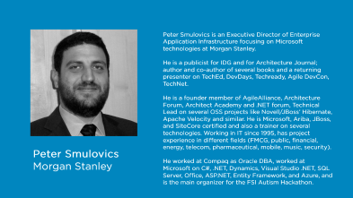
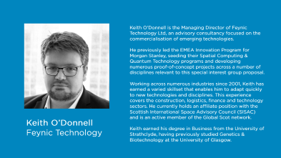
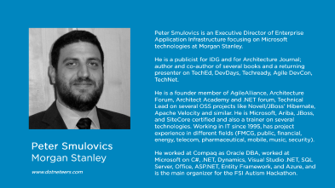
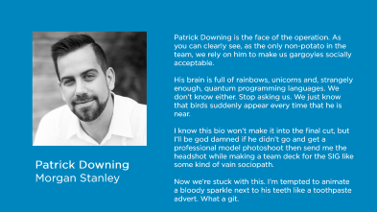
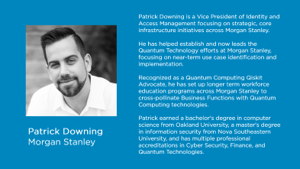
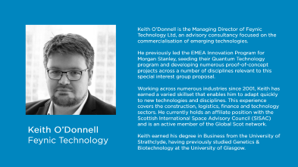
Drivers
SIG Team

Slide 5
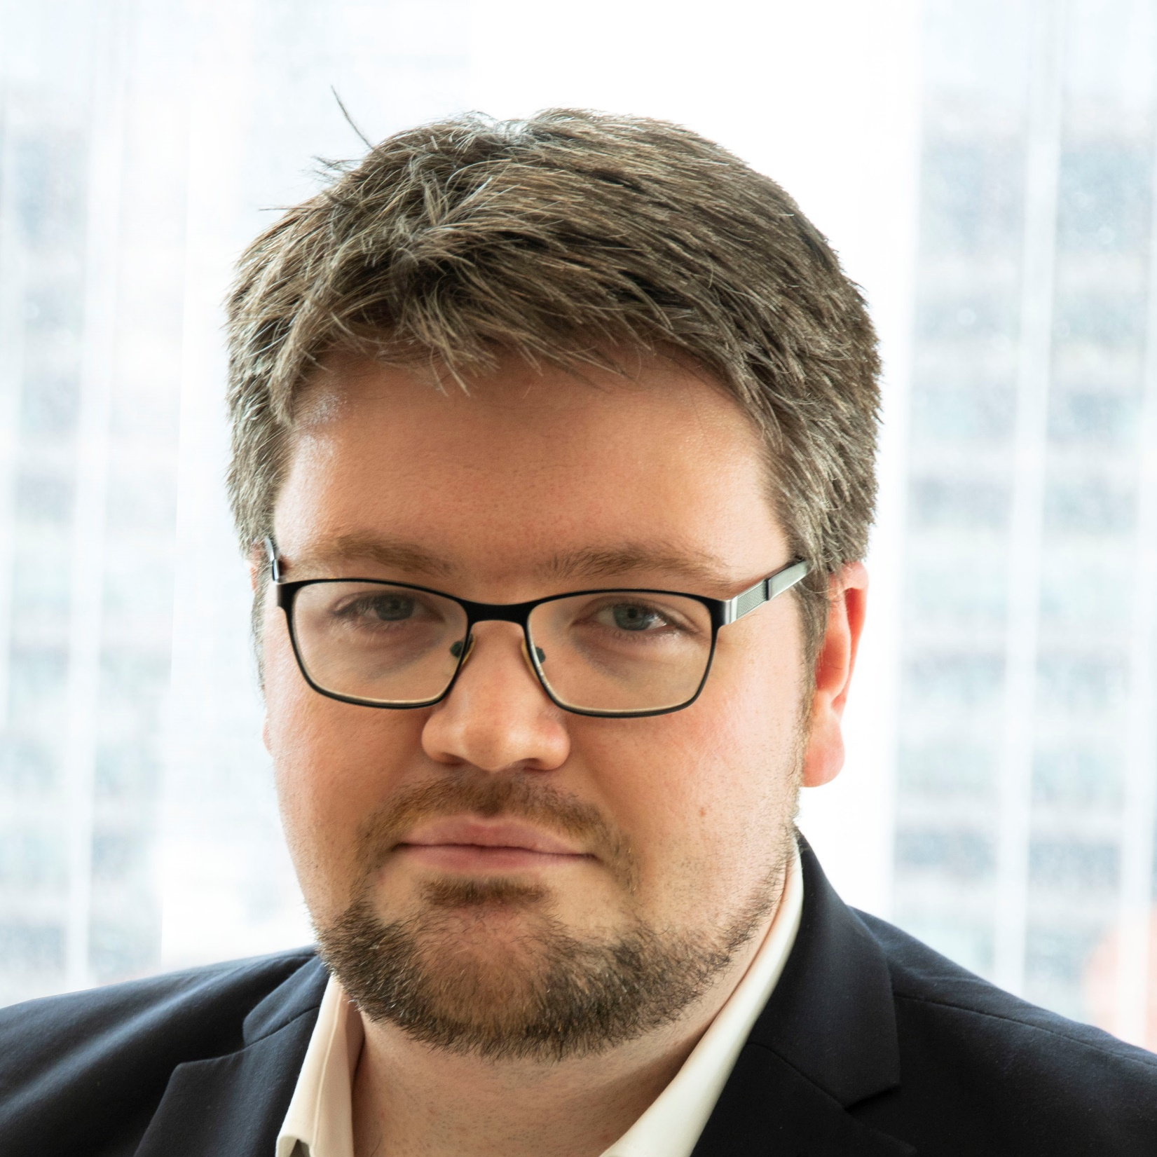
Keith O’Donnell is the Managing Director of Feynic Technology Ltd, an advisory consultancy focused on the commercialisation of emerging technologies.
He previously led the EMEA Innovation Program for Morgan Stanley, seeding their Spatial Computing & Quantum Technology programs and developing numerous proof-of-concept projects across a number of disciplines relevant to this special interest group proposal.
Working across numerous industries since 2001, Keith has earned a varied skillset that enables him to adapt quickly to new technologies and disciplines. This experience covers the construction, logistics, finance and technology sectors. He currently holds an affiliate position with the Scottish International Space Advisory Council (SISAC) and is an active member of the Global Scot network.
Keith earned his degree in Business from the University of Strathclyde, having previously studied Genetics & Biotechnology at the University of Glasgow.
Keith O’Donnell
Feynic Technology

Slide 6
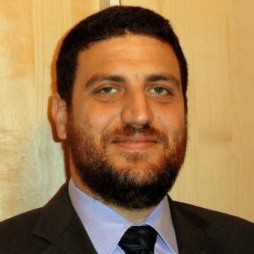
Peter Smulovics is an Executive Director of Enterprise Application Infrastructure focusing on Microsoft technologies at Morgan Stanley.
He is a publicist for IDG and for Architecture Journal; author and co-author of several books and a returning presenter on TechEd, DevDays, Techready, Agile DevCon, TechNet.
He is a founder member of AgileAlliance, Architecture Forum, Architect Academy and .NET forum, Technical Lead on several OSS projects like Novell/JBoss’ Hibernate, Apache Velocity and similar. He is Microsoft, Ariba, JBoss, and SiteCore certified and also a trainer on several technologies. Working in IT since 1995, has project experience in different fields (FMCG, public, financial, energy, telecom, pharmaceutical, mobile, music, security).
He worked at Compaq as Oracle DBA, worked at Microsoft on C#, .NET, Dynamics, Visual Studio .NET, SQL Server, Office, ASP.NET, Entity Framework, and Azure, and is the main organizer for the FSI Autism Hackathon.
Peter Smulovics
Morgan Stanley www.dotneteers.com

Slide 7
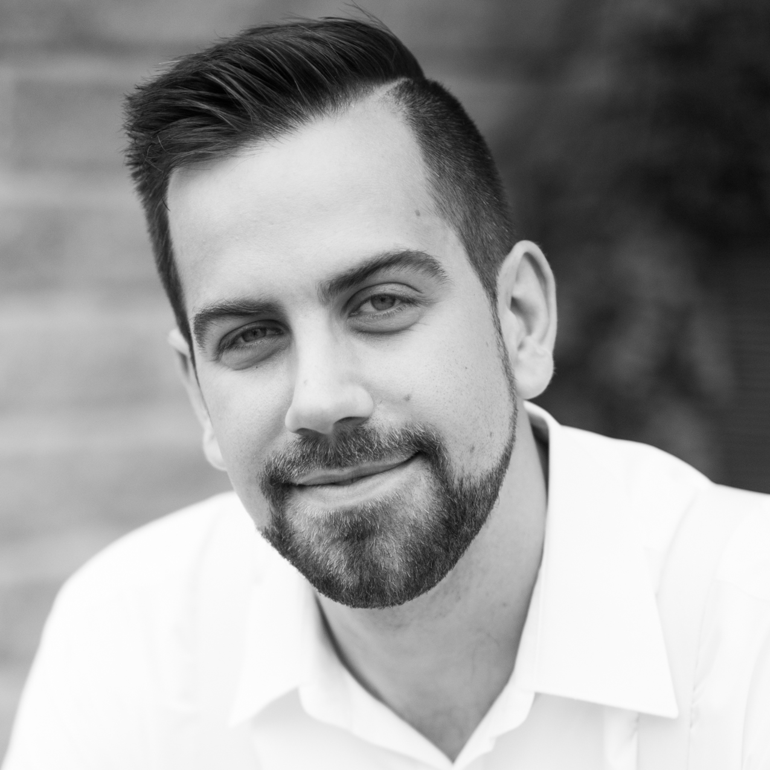
Patrick Downing is a Vice President of Identity and Access Management focusing on strategic, core infrastructure initiatives across Morgan Stanley.
He has helped establish and now leads the Quantum Technology efforts at Morgan Stanley, focusing on near-term use case identification and implementation.
Recognized as a Quantum Computing Qiskit Advocate, he has set up longer term workforce education programs across Morgan Stanley to cross-pollinate Business Functions with Quantum Computing technologies.
Patrick earned a bachelor's degree in computer science from Oakland University, a master's degree in information security from Nova Southeastern University, and has multiple professional accreditations in Cyber Security, Finance, and Quantum Technologies.
Patrick Downing
Morgan Stanley

Slide 8
Background
Emerging
Technology
SIG
2. Process
3. Support
1. Vision
1. Vision

Slide 9
“Tell me, and I forget
Teach me, and I may remember
1. Vision
Involve me, and I learn”
Benjamin Franklin

Slide 10

Initial Technologies
Artificial Intelligence | 4D Printing
Blockchain & DLT | Biotechnology
IOT, 5G & 6G | Metaverse & Spatial Computing
Robotics & RPA | Graphene
Spatial Computing | Natural Language Processing
Quantum Technology | Advanced Data Processing
Neural Links | Cloud Computing
Space Technology | Crypto Agility
To lead the FinTech Industry as the most trusted source of Emerging Technologies knowledge & experience
1. Vision
2. Process

Slide 11





2. Process
3. Support

Slide 12

Emerging Technologies Positioning & Explainers

Slide 13
Primers on fundamentals
Core Points:
Primers
Practical application outlines
Defining a Brain Trust
Showcase of Academia
Emerging Technology Positioning & Explainers

Slide 14
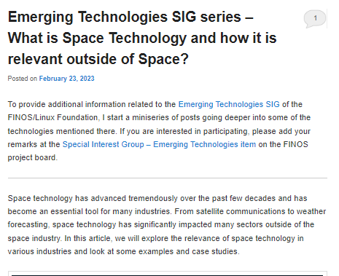
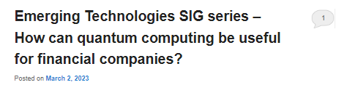
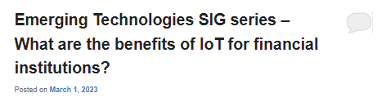
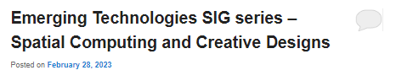
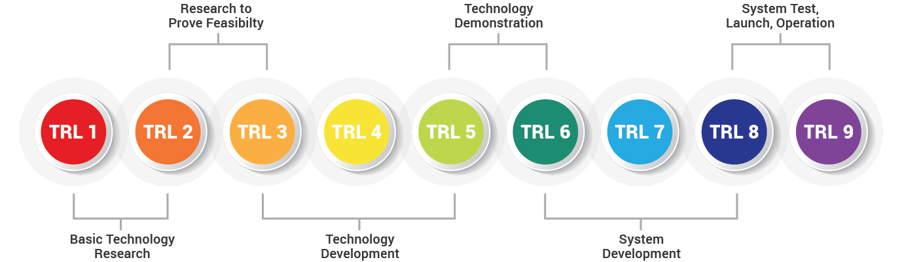
Primers on fundamentals
Created by recognised subject matter experts (SMEs)
Introduction to the subject & relevant reading to seed knowledge
Open comments for further discussion and follow-ups
Details various Technology Readiness Levels of the underlying technology

Slide 15
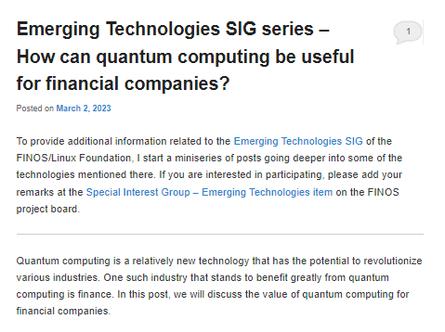
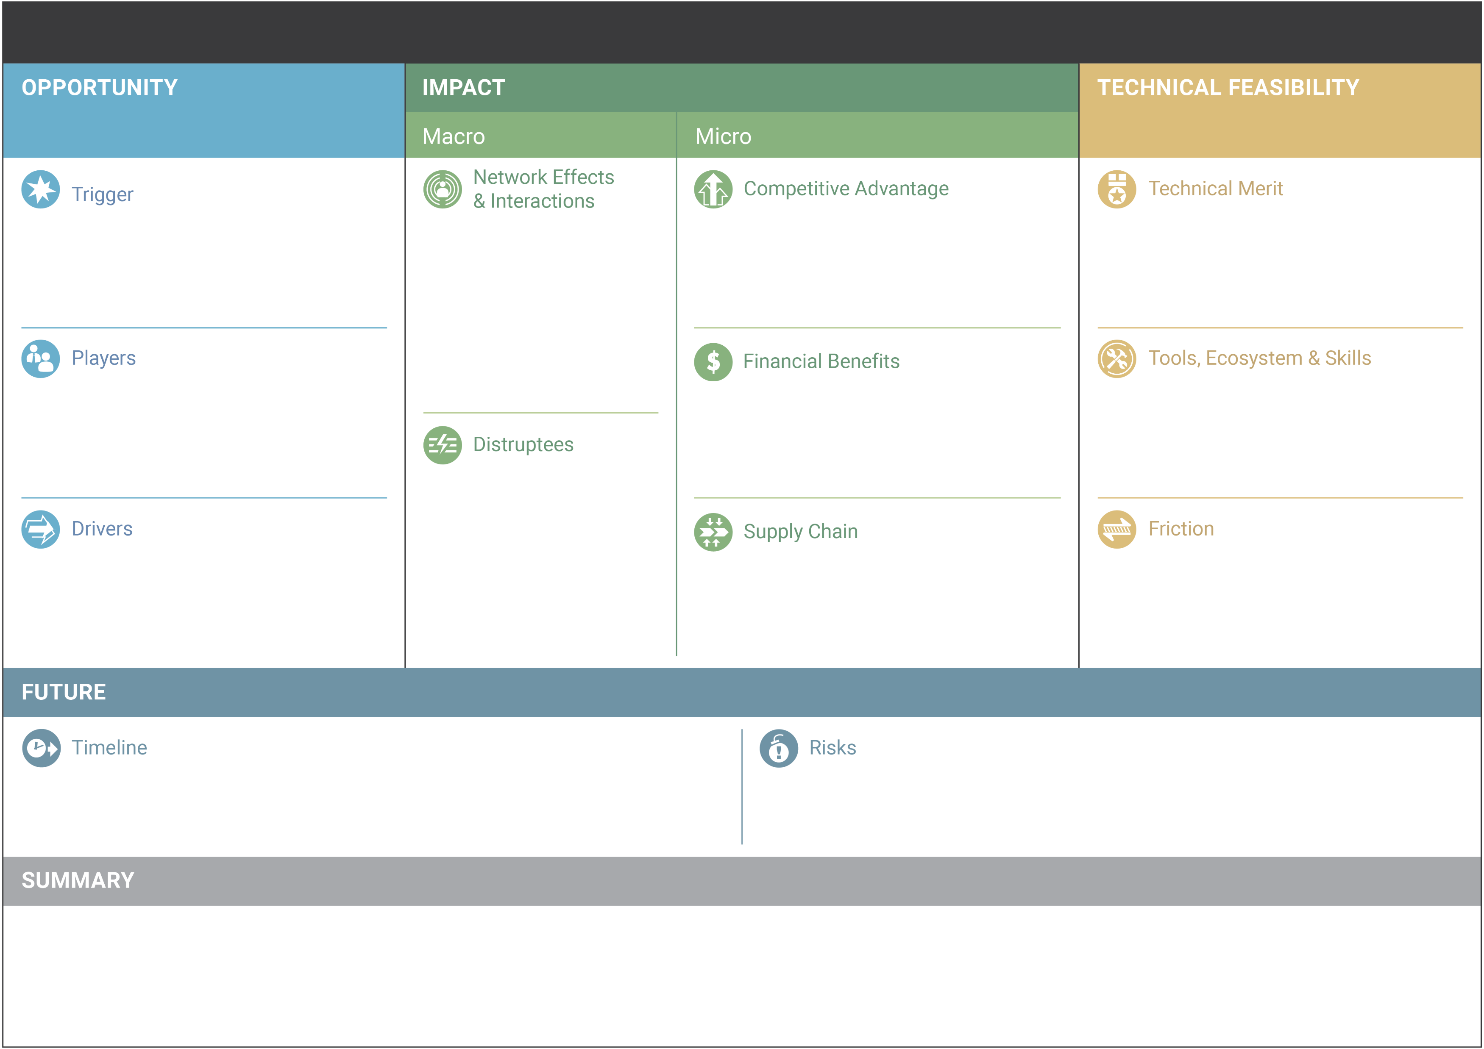
Primers on fundamentals
Outline of practical applications
Emerging Technologies Analysis Canvas asset will also be created
Sits alongside the primer in the repository
Aligns to Business Model Canvas
Details can be found at https://github.com/wso2/ETAC

Slide 16
Primers on fundamentals
Outline of practical applications
Brain Trust
Highlight existing efforts to develop & deliver technology solutions
Identify current gaps that need to be explored to seed widespread adoption
Point towards existing efforts to address gaps that remove duplication of effort
Call-to-arms for required exploration

Slide 17





Outline of practical applications
Brain Trust
Identify relevant SMEs who can advise on the applicability or viability of exploration projects
Requires accreditation (awarded by FINOS) that is evaluated under 5 criteria:
Education & Training
Body of Work
Skills & Awards
Professionalism & Ethics
Continual Development

Slide 18


Brain Trust
Showcase of Academic Research
Brain Trust composition will include members from:
Industry / Enterprise
Academia
Entrepreneurs
Legal Professionals
Governance
Theory
Technical
Commercial

Slide 19
Emerging Technology Positioning & Explainers
Brain Trust
Showcase of Academic Research
Spotlight existing research around the globe
Allow researchers to explain key topics or share insights
Increase collaboration with academic research
Theory
Technical
Commercial

Slide 20
Emerging Technology Positioning & Explainers

Slide 21

Develop & Curate Open Source Libraries

Slide 22
Creation of standards for quick starting or sandboxing
Attempt to harmonise with existing FINOS initiatives
Development of Open Source Libraries

Slide 23








Initial Technologies
Artificial Intelligence | 4D Printing
Blockchain & DLT | Biotechnology
IOT, 5G & 6G | Metaverse & Spatial Computing
Robotics & RPA | Graphene
Spatial Computing | Natural Language Processing
Quantum Technology | Advanced Data Processing
Neural Links | Cloud Computing
Space Technology | Crypto Agility
TBD
Find out more at https://landscape.finos.org/

Slide 24
Develop & Curate Open Source Libraries

Slide 25

General POCs to prove out new technologies

Slide 26

The Process
Exploration program within the SIG aiming to test concepts and create new projects
Encourages new members to join & participate
Maximum duration and funding limits imposed
Projects subject to a vetting process
General POCs to prove out new technologies

Slide 27

Step 1: Opportunity Outline
Create Primer
Outline where disruption is possible or worth exploring
The Process

Slide 28


Step 2: Call for Ideas
From opportunities outlined, define the problem statement
Create a call-to-arms to source proposed solutions
Enable re-use of shelved projects alongside fresh ideas
The Process

Slide 29

Step 3: SME Vetting
Sanity check by the Brain Trust to confirm ideas are:
Possible
Feasible
Worthwhile
Legal
Not already explored
The Process

Slide 30

Step 4: Value Proposition
A value proposition is created by the Brain Trust & SIG maintainers
Dependent on available budget & availability of Support Services, priority is given to projects with higher perceived value vs required investment
The Process

Slide 31

Step 5: Funding Governance
A pool of representatives from FINOS vote to approve access to exploration funds or resources to facilitate exploration
Funding would have a per project cap on both budget and duration
Projects without asks can skip this step
The Process

Slide 32

Step 6: Commencement & Updating
Participants must provide regular public updates to access funding or resources
If a project becomes unviable, a record is kept and funding/resources are reclaimed
Shelved projects are stored for possible future exploration
The Process

Slide 33

Step 7: Showcasing
Upon project completion, demos and project walkthroughs are recorded to share intelligence with future users
These should cover:
pain points
ideas on how to improve
solutions for common issues
The Process

Slide 34
Step 8: Source Release & Maintenance
Project participants share their repositories publicly on the FINOS master
Innovators are accredited for their efforts
Perpetuation of support for open source collaboration is the goal
The Process

Slide 35
General POCs to prove out new technologies

Slide 36






Key Asks
3. Support
2. Process

Slide 37

Enterprise
Technology
Passporting

Slide 38

Security
Liabilities
Technology
Passporting
Enterprise
Trust
Readiness

Slide 39
Security
Liabilities
Enterprise
Trust
Readiness

Slide 40
Trust
Security
Research
Early Stage
Enterprise
Readiness
Liabilities

Slide 41
Trust
Security
Research
Early Stage
Enterprise
Readiness
Liabilities

Slide 42
Trust
Security
Research
Early Stage
Enterprise
Readiness
Liabilities

Slide 43
Trust
Security
Research
Early Stage
Enterprise
Readiness
Liabilities

Slide 44

Trust
Security
Research
Early Stage
Enterprise
Readiness
Liabilities

Slide 45


Trust
Security
Passporting
Research
Early Stage
Enterprise
Readiness
Liabilities

Slide 46
Passporting
Establishes trust between parties
Streamlines on-boarding
Stimulates proliferation and use of open source
Improves growth of innovators’ companies
Builds relationships between small enterprise and large corporates

Slide 47
Tech
Passporting

Slide 48

Support
Services

Slide 49






Support
Services
Tools and platforms
Licenses
Compute time
Sandboxes
Assets
Technical Support/Advice
Professional Services
Pre-trained staff
Support for innovators
Assist skills development
Enable innovation at scale
Post-adoption, staffing-in-a-box managed services
* Companies are indicative based on existing FINOS membership or pre-engagement with the SIG
Examples

Slide 50
Tools and platforms
Professional Services
Examples
* Companies are indicative based on existing FINOS membership or pre-engagement with the SIG
Notes:
As examples, FINOS members such as Google Cloud or the Linux Foundation can co-invest in ideas to ensure their tools and environments have first mover advantage in early project prototypes.
Services companies such as Synechron and Accolite can support exploration with labour and skills. This isn’t a prescriptive list, but we wanted to avoid logo barrage on this slide. We’ve selected these four due to their existing membership or, in the case of Accolite, pre-engagement that we have had while forming our SIG proposal

Slide 51
During POC phase:
Element of free or heavily subsidised rates
Post-POC phase:
Assistance to showcase benefits of new technology
Continued engagement and support of Open Source projects

Slide 52
During POC phase:
Element of free or heavily subsidised rates
Post-POC phase:
Agreement to support any projects at fixed costs for adopters
Confirmation that staff can work with setup/integration teams

Slide 53
Support
Services

Slide 54

Talent Development Strategy for Emerging Technologies

Slide 55
Time
Rapid Upskilling Materials
Developed in conjunction with Brain Trust, Project Teams and Support Services
Learning outcomes and pain points converted into materials
Materials used to train future users of the open source technology
Improves adoptability at scale
Talent Development Strategy for Emerging Technology

Slide 56


Future User
Time
Rapid Upskilling Materials
Developed in conjunction with Brain Trust, Project Teams and Support Services
Learning outcomes and pain points converted into materials
Materials used to train future users of the open source technology
Improves adoptability at scale
Innovator
Discovered knowledge through exploration
Brain Trust
User
Pre-existing subject matter expertise
Implementation knowledge gained through re-use

Slide 57


Future User
Brain Trust
Innovator
User

Slide 58
Talent Development Strategy for Emerging Technologies

Slide 59


Key Asks
Vendors willing to provide support services, please get in touch! We are actively looking for partners to help us deliver
If you would like to take part in the SIG, reach out to us
We are actively seeking Brain Trust members
Initial Technologies
Artificial Intelligence | 4D Printing
Blockchain & DLT | Biotechnology
IOT | 5G & 6G
Robotics & RPA | Graphene
Spatial Computing | Natural Language Processing
Quantum Technology | Advanced Data Processing
Neural Links | Cloud Computing
Space Technology | Crypto Agility
3. Support

Slide 60


Key Asks
Approval on SIG direction
Budget for accreditations & POC program
FINOS backing to agree Support Services with pre-approved Vendors
Participation from people on this call

